Slide 1
Learning Coding and Modulation with Autoencoders
Alan Wang
Summer Intern Presentations
7/24/19

Slide 2
Main Idea
Encoding
Modulation
Channel
Demodulation
$$s$$
𝑠
$$\hat{s}$$
𝑠 ̂
Decoding

Slide 3
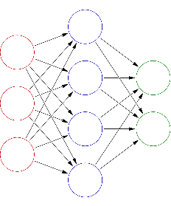
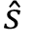
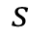
Main Idea
Encoding
Modulation
Channel
Demodulation
$$s$$
𝑠
$$\hat{s}$$
𝑠 ̂
Decoding
Encoder
Decoder
Channel
$$s$$
$$\hat{s}$$
Autoencoder

Slide 4
Main Idea
Encoding
Modulation
Channel
Demodulation
$$s$$
𝑠
$$\hat{s}$$
𝑠 ̂
Decoding
Encoder
Decoder
Channel
$$s$$
$$\hat{s}$$
Autoencoder

Slide 5
Outline
Background
Model Details
Model Experiments
AWGN Channel
AWGN + Filtering Channel
Partial Band AWGN
Time-varying Noise
Summary and Conclusions

Slide 6
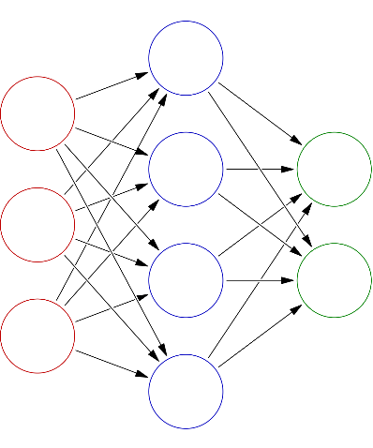
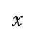
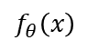
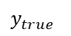
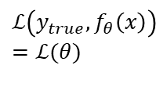
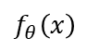
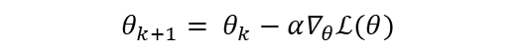
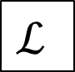
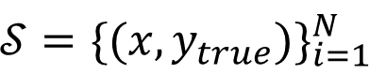
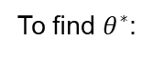
Background: Neural Networks
Training Set $𝒮$
Training Set 𝒮
Samples
Network Architecture $f_{θ}(x)$
Network Architecture 𝑓_𝜃 (𝑥)
Composition of Parametrized functions
Loss Function $ℒ(y_{pred}, y_{true})$
Loss Function ℒ(𝑦_𝑝𝑟𝑒𝑑, 𝑦_𝑡𝑟𝑢𝑒)
Iteratively take derivatives to find parameters that minimize loss
Ground truths
$${{y_{pred}=f}_{θ}\left(x\right)= F}_{1}(F_{2}(… \left(F_{L}\left(x\right)…\right))$$
$$y_{true}$$
$$ℒ$$
$$ℒ\left(y_{true},f_{θ}\left(x\right)\right)=ℒ(θ)$$
$$f_{θ}\left(x\right)$$
$${𝒮=\{(x,y_{true})\}}_{i=1}^{N}$$
To find $θ^{∗}$:
$$x$$
$$f_{θ}\left(x\right)$$
Repeat…
$$θ_{k+1}= θ_{k}−α∇_{θ}ℒ(θ)$$
…until convergence

Slide 7
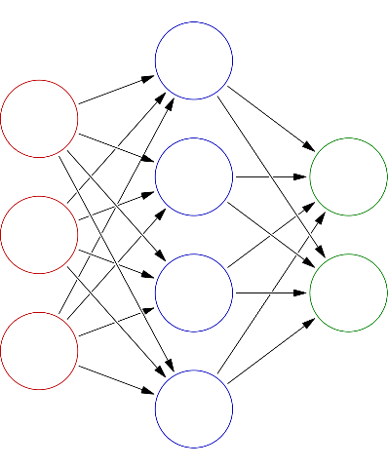
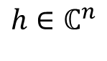
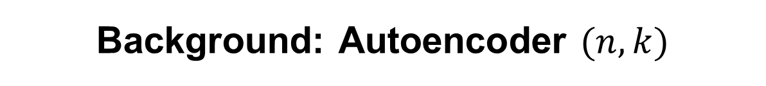
Background: Autoencoder $(n, k)$
Encoder $ℰ$
Encoder ℰ
Decoder $𝒟$
Decoder 𝒟
$$\hat{s}∈ℝ^{k}$$
𝑠 ̂∈ℝ^𝑘
$$s∈ℝ^{k}$$
𝑠∈ℝ^𝑘
$$h∈ℂ^{n}$$

Slide 8
Main Idea
Encoding
Modulation
Channel
Demodulation
$$s$$
𝑠
$$\hat{s}$$
𝑠 ̂
Decoding
Encoder
Decoder
Channel
$$s$$
$$\hat{s}$$
Autoencoder

Slide 9
Outline
Background
Model Details
Model Experiments
AWGN Channel
AWGN + Filtering Channel
Partial Band AWGN
Time-varying Noise
Summary and Conclusions

Slide 10
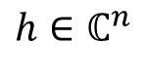
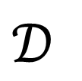
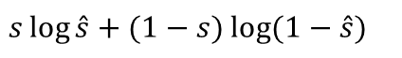
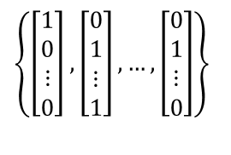
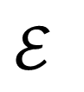
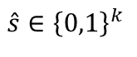
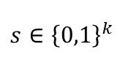
Autoencoder Details
$$h∈ℂ^{n}$$
$$s∈{\left\{0,1\right\}}^{k}$$
$$ℰ$$
$$𝒟$$
$$\hat{s}∈{\left\{0,1\right\}}^{k}$$
$$𝒮$$
𝒮
Random bit vectors of length $k$
Random bit vectors of length 𝑘
$$f_{θ}(x)$$
𝑓_𝜃 (𝑥)
Linear
$$ℒ(s,\hat{s})$$
ℒ(𝑠,𝑠 ̂)
Binary Cross Entropy
ReLU
BatchNorm
Sigmoid
$$\left\{\left[\begin{matrix}1 \\ 0 \\ ⋮ \\ 0\end{matrix}\right],\left[\begin{matrix}0 \\ 1 \\ ⋮ \\ 1\end{matrix}\right],…,\left[\begin{matrix}0 \\ 1 \\ ⋮ \\ 0\end{matrix}\right]\right\}$$
$$s\log{\hat{s}+(1−s)\log{(1−\hat{s})}}$$

Slide 11
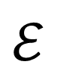
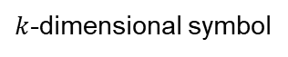
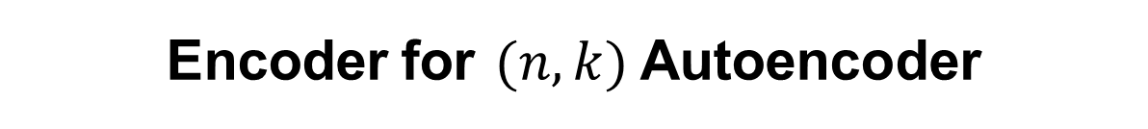
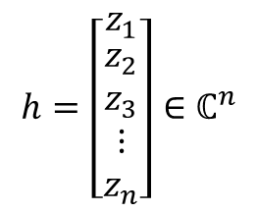
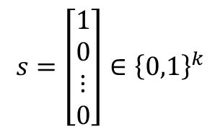
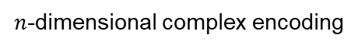
Encoder for $(n, k)$Autoencoder
$$ℰ$$
Linear
ReLU
Batch Normalization
Linear
Normalization
$$s=\left[\begin{matrix}1 \\ 0 \\ ⋮ \\ 0\end{matrix}\right]∈{\left\{0,1\right\}}^{k}$$
$$h=\left[\begin{matrix}z_{1} \\ \begin{aligned}z_{2} \\ z_{3}\end{aligned} \\ ⋮ \\ z_{n}\end{matrix}\right]∈ℂ^{n}$$
Channel
$k$-dimensional symbol
$n$-dimensional complex encoding

Slide 12
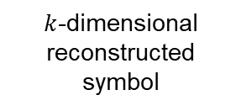
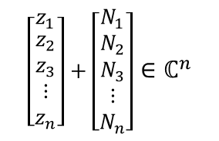
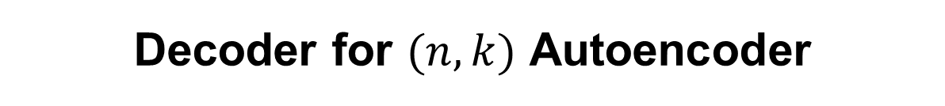
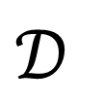
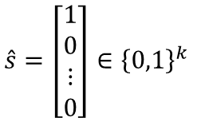
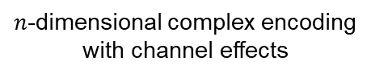
Decoder for $(n, k)$ Autoencoder
$$𝒟$$
Linear
ReLU
Batch Normalization
Linear
Sigmoid
$$\left[\begin{matrix}z_{1} \\ \begin{aligned}z_{2} \\ z_{3}\end{aligned} \\ ⋮ \\ z_{n}\end{matrix}\right]+\left[\begin{matrix}N_{1} \\ \begin{aligned}N_{2} \\ N_{3}\end{aligned} \\ ⋮ \\ N_{n}\end{matrix}\right]∈ℂ^{n}$$
$$\hat{s}=\left[\begin{matrix}1 \\ 0 \\ ⋮ \\ 0\end{matrix}\right]∈{\left\{0,1\right\}}^{k}$$
Channel
$n$-dimensional complex encoding
with channel effects
$k$-dimensional reconstructed symbol

Slide 13
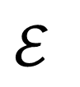
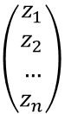
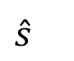
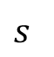
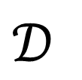
Channel
$$ℰ$$
Channel
$$\left(\begin{aligned}z_{1} \\ z_{2} \\ … \\ z_{n}\end{aligned}\right)$$
$$s$$
$$𝒟$$
$$\hat{s}$$

Slide 14
Channel
$$ℰ$$
Channel
$$\left(\begin{aligned}z_{1} \\ z_{2} \\ … \\ z_{n}\end{aligned}\right)$$
$$s$$
$$𝒟$$
$$\hat{s}$$
How does the Autoencoder network react to different channel models?
How does the Autoencoder perform relative to other coding/modulation schemes?

Slide 15
Outline
Background
Model Details
Model Experiments
AWGN Channel
AWGN + Filtering Channel
Partial Band AWGN
Time-varying Noise
Summary and Conclusions

Slide 16
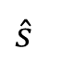
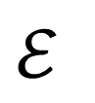
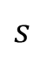
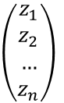
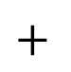
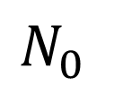
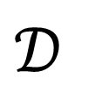
AWGN Channel
Channel
$$ℰ$$
$$\left(\begin{aligned}z_{1} \\ z_{2} \\ … \\ z_{n}\end{aligned}\right)$$
$$s$$
$$+$$
$$𝒟$$
$$\hat{s}$$
$$N_{0}$$

Slide 17
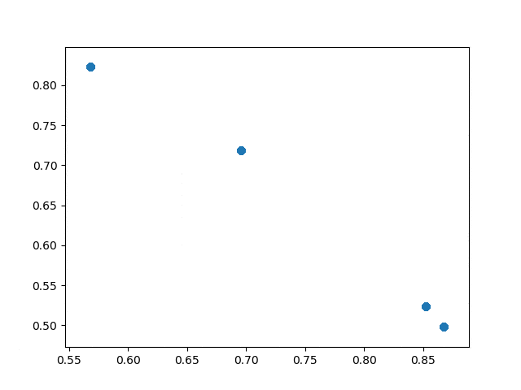
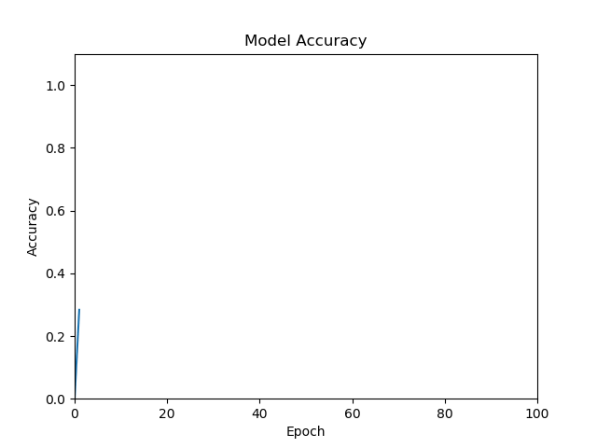
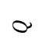

Constellation Learning with Unit Amplitude Constraint
$(2,2)$Autoencoder Constellation Plot, Unit Amplitude
$$Q$$
$$I$$

Slide 18



Constellation Learning with Unit Amplitude Constraint
$(2,4)$Autoencoder Constellation Plot, Unit Amplitude
$$Q$$
$$I$$

Slide 19

Constellation Learning with Total Energy Constraint
$(2,4)$Autoencoder Constellation Plot, Total Energy
$$Q$$
$$I$$

Slide 20


More Constellations

Slide 21

Comparison with Extended BCH and QPSK

Slide 22
Outline
Background
Model Details
Model Experiments
AWGN Channel
AWGN + Filtering Channel
Partial Band AWGN
Time-varying Noise
Summary and Conclusions

Slide 23



AWGN + Filtering Channel
Channel
$$ℰ$$
$$\left(\begin{aligned}z_{1} \\ z_{2} \\ … \\ z_{n}\end{aligned}\right)$$
$$s$$
$$H(ω)$$
$$+$$
$$𝒟$$
$$\hat{s}$$
$$N_{0}$$

Slide 24

Filter Learning, Low Pass Filter
Magnitude
Frequency Spectrum

Slide 25

Filter Learning, Weird Filter
Magnitude
Frequency Spectrum

Slide 26

Filter Learning, Weirder Filter
Magnitude
Frequency Spectrum

Slide 27

Filter Learning with Shifting Cutoff
Magnitude
Frequency Spectrum

Slide 28

Shifting vs. Non-shifting Cutoff
Accuracy
Epoch

Slide 29
Outline
Background
Model Details
Model Experiments
AWGN Channel
AWGN + Filtering Channel
Partial Band AWGN
Time-varying Noise
Summary and Conclusions

Slide 30

Partial Band AWGN Channel
Channel
$$ℰ$$
$$\left(\begin{aligned}z_{1} \\ z_{2} \\ … \\ z_{n}\end{aligned}\right)$$
$$s$$
$$+$$
$$𝒟$$
$$\hat{s}$$
$$N_{0}∗h(t)$$

Slide 31

Partial Band Noise Learning, Wide Band

Slide 32

Partial Band Noise Learning, Narrow Band

Slide 33

Partial Band, Changing Bands

Slide 34

Fast Time-Varying Channel
Magnitude
Frequency Spectrum

Slide 35

Fast Time-Varying Channel with Autoencoder
Magnitude
Frequency Spectrum

Slide 36
Outline
Background
Model Details
Model Experiments
AWGN Channel
AWGN + Filtering Channel
Partial Band AWGN
Fast Time-varying Noise with RNNs
Summary and Conclusions

Slide 37















Aside: Recurrent Neural Network
$$y_{t}$$
$$y_{t−1}$$
$$y_{t}$$
$$y_{t+1}$$
$$h_{t−1}$$
$$h_{t}$$
$$h_{t+1}$$
$$h_{t}$$
$$=$$
$$x_{t−1}$$
$$x_{t}$$
$$x_{t+1}$$
$$x_{t}$$

Slide 38
Aside: Autoencoder vs. RNN
Autoencoder
$y=𝒟(h)$, where $h=ℰ\left(x\right)$
𝑦=𝒟(ℎ), where ℎ=ℰ(𝑥)
Hidden state $h$ is not a function of past hidden states
Hidden state ℎ is not a function of past hidden states
Data is fed independently during training
RNN
$y_{t}=𝒟(h_{t})$, where $h_{t}=ℰ(x_{t}, h_{t−1})$
𝑦_𝑡=𝒟(ℎ_𝑡), where ℎ_𝑡=ℰ(𝑥_𝑡, ℎ_(𝑡−1))
Hidden state $h_{t}$ is dependent on past hidden state $h_{t−1}$
Hidden state ℎ_𝑡 is dependent on past hidden state ℎ_(𝑡−1)
Data is fed as a sequence of time-dependent information during training

Slide 39

Fast Time-Varying Channel with RNN
Magnitude
Magnitude
Magnitude
Frequency Spectrum
Frequency Spectrum

Slide 40

Autoencoder vs. RNN

Slide 41


Time-Varying Channel with RNN
Magnitude
Accuracy
Epoch
Frequency Spectrum

Slide 42
Outline
Background
Model Details
Model Experiments
AWGN Channel
AWGN + Filtering Channel
Convolved AWGN
Time-varying Noise
Summary and Conclusions

Slide 43
Summary
Deep learning models are comparable to traditional methods and offer flexibility and adaptability
Autoencoders can learn complex code representations that are robust to time-invariant channel effects, but suffer amidst time-varying ones
RNNs offer the ability to learn time-varying channel effects due to “memory” or “state” information, but suffer from longer training time and accuracy

Slide 44
Future Work
Hyper-parameter tuning
More encoder/decoder layers
Different losses or optimizers
Complex batch normalization
Robust RNN with more complex channel learning
Applications to jamming and interference scenarios

